Slide 1
Curriculum Pathways Policy

Slide 2
Policy Number | Version | Date | Policy Owner | Review Frequency | Review Date
ED 3 | 6 | September 2023 | Lauren Tallis | Annually | September 2024
Approved by | Name | Date
Headteacher | Lauren Tallis | September 2023
Education Review Board |  | September 2023
Version | Review Description | Date
1 | Re-written to reflect changes in school and student’s needs, new policy format | January 2019
2 | Policy changed to reflect changes in SLT, and added amendments following Ofsted monitoring visit report | November 2019
3 | Policy changed to reflect changes in personnel | March 2020
4 | Policy changed to reflect new curriculum pathway | September 2021
5 | Policy updated | September 2022
6 | Policy updated | September 2023

Slide 3
“If a child cannot learn in the way we teach, we much teach in a way they can learn”
Based on a quote from Ignacio Estrada, as cited in McInerney, 2015.

Slide 4
This policy is written in line with the following:
Independent School Standards, 2019
Equality Act 2010
National Curriculum, 2014
DfE “Careers Strategy: Making the most of everyone’s skills and talents” 2017.
Preparation for Adulthood Outcomes, 2017

Slide 5
Links with other policies
Admissions Policy
SEND Policy
Assessment Policy
Careers and Post-16 Policy
Equal Opportunities (Young People) Policy
PSHE/RSE Policy
Safeguarding and Child Protection Policy

Slide 6
Aims and Implementation
At Our Place School we are proud of the fact that we aim to shape what we do according to the individual students on roll. As such, we are flexible to how we devise and deliver the curriculum we offer and will continue to adapt and refine it as the need arises. We aim for our curriculum to be inclusive of all our students needs.
Using our assessment and knowledge of students, we plan our curriculum to encourage next phases of learning to support progress. We work hard to identify and remove barriers to learning by using our expertise, sensitivity, perception and adaptability to respond to the student’s changing social and emotional needs. We provide opportunities to experience challenge and success and know when to ease off when frustration / lack of resilience begins to show.
We know that our students respond to innovative and flexible approaches to learning and therefore use these to motivate and promote curiosity and intrigue. We believe that students learn in different ways, so we modify our teaching styles and resources to match student’s learning styles. We allow students to make mistakes without undue criticism and we give them time to be successful. We value all attempts and contributions. We actively promote that the students have ownership in their own learning and if they are self-motivated in a particular area, this is encouraged and supported. We encourage our students to persevere and thus develop resilience.

Slide 7
Our Place School Curriculum Map: Safeguarding Futures
Core
Applied
Active

Slide 8
Our Place School Curriculum Pathways: Safeguarding Futures
Minimum age of admission
Further Education provision
Maximum age for Our Place School

Slide 9
Regardless of the pathway, the values, key skills and the outcome remains the same
Feeling safe and happy, being responsible, active citizens, being as independent as possible and contributing to society.
Communication
Literacy
Numeracy
Digital Literacy
Physical and Mental Health
Awareness of the world around us
PSHE
RSE
Emotional Wellbeing
Staying Safe
SMSC
Applied
Core
OPPORTUNITY
POTENTIAL
SAFETY
Active

Slide 10
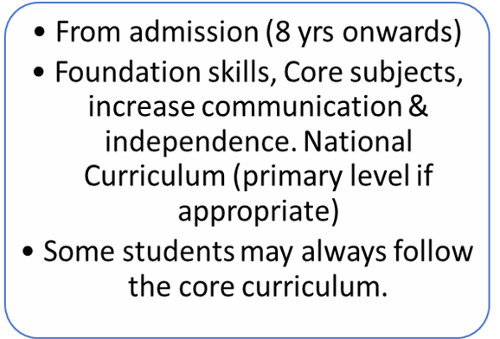
Core Curriculum & Pathway
Outdoor learning
Social skills
Core subjects
Preparation for Adulthood
Communication
Increase Independence
Sensory input
Key Skills
Accreditation
Off-site learning
National Curriculum
Pre-Key stage Outcomes
Engagement Model
Communication
Literacy
Numeracy
Digital Literacy
Physical and Mental Health
Awareness of the world around us
PSHE
RSE
Emotional Wellbeing
Staying Safe
SMSC

Slide 11
Applied Curriculum & Pathway
Outdoor learning
Social skills, active citizens
Core subjects
Preparation for Adulthood, Increased independence
Communication – written, verbal, non-verbal
Functional Skills, used: cooking/ cleaning
Sensory input/self regulation
Key Skills
Accreditation & Qualification
Off-site learning
National Curriculum
Money Skills, understanding value of money
Careers Guidance/ work skills
Communication
Literacy
Numeracy
Digital Literacy
Physical and Mental Health
Awareness of the world around us
PSHE
RSE
Emotional Wellbeing
Staying Safe
SMSC

Slide 12
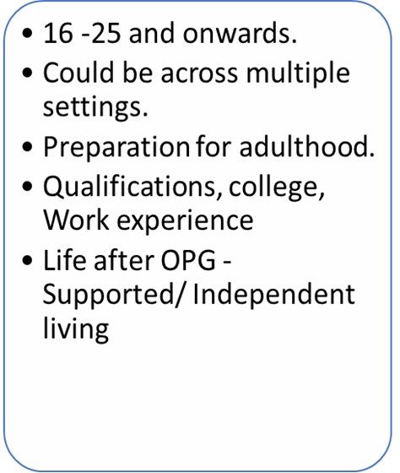
Active Curriculum & Pathway
Outdoor learning
Social skills, relationships outside of OPG
Staying Healthy
Preparation for Adulthood
Effective Communication
Independence skills
Financial awareness
Key Skills
Accreditation and Qualifications
Off-site learning
Life skills – budgeting, cleaning, cooking
Work Experience/ apprenticeship
Education off-site, college
Communication
Literacy
Numeracy
Digital Literacy
Physical and Mental Health
Awareness of the world around us
PSHE
RSE
Emotional Wellbeing
Staying Safe
SMSC

Slide 13
Our Place School Curriculum Pathways: Safeguarding Futures

